Slide 1
Transformational Leadership Through Effective Internal Communication
Lectures Based on
Leadership Communication, 4th edition
By Deborah J. Barrett, Ph.D.
Copyright © 2014 McGraw-Hill Education. All rights reserved. No reproduction or distribution without the prior written consent of McGraw-Hill Education.

Slide 2
Discussion Topics
Selecting an appropriate leadership style and communication approach
Using visions and missions to strengthen internal communication
Designing an effective change communication program
13-2

Slide 3

Leaders Should Select Their Styles Carefully
Visionary
Highly positive
Coaching
Affiliative
Democratic
Positive
Pacesetting
Highly negative
Commanding
13-3
Source: Goleman, Boyatzis, and McKee. (2002). Primal Leadership: Realizing the Power of Emotional Intelligence. Boston: Harvard Business School Press.

Slide 4
Different Leadership Styles Should Be Used Appropriately
Style | How builds resonance | When appropriate
Visionary | Moves people toward shared goals and dreams | When changes require a new vision or a new direction is needed
Coaching | Connects a person’s wants with the organization’s goals | To help an employee improve performance by building long-term capabilities
Affiliative | Creates harmony by connecting people to each other | To heal rifts in a team, motivate during stressful times, or strengthen connections
Democratic | Values people’s input and gets commitment through participation | To build buy-in or consensus, or to get valuable input from employees
Pacesetting | Meets challenging and exciting goals | To get high-quality results from a motivated and competent team
Commanding | Soothes fears by giving clear direction in an emergency | In a crisis, to kick-start a turn-around, or problem employees
13-4

Slide 5
Transformational Leaders are Mostly Visionary and Affiliative
Transformation leaders
Emphasize new possibilities
Promote a compelling vision
Connect with others individually and in groups
They depend on the following when communicating with internal audiences:
Authenticity and credibility (a positive ethos)
Emotional intelligence
Mentoring and coaching abilities
13-5

Slide 6
The Objectives of Effective Employee Communication
Educate employees in the organization’s culture, vision, and strategic goals
Motivate support for organization’s goals
Encourage higher performance and discretionary effort
Limit misunderstandings that may damage productivity
Align employees behind organization’s performance objectives and position them to help achieve them
13-6

Slide 7
Strategic Employee Communication Model
Supportive Management
On-going
Assessment
Targeted
Messages
Well-positioned Staff
Effective Media/
Forums
13-7

Slide 8
Best Practice Definition of
Model Components
Component
Strategic objectives
Supportive management
Targeted
messages
Effective media/Forums
Best Practice Definition
Communications used to reinforce strategic objectives and to ensure employees understand new direction
Top-level management involved in and actively assuming responsibility for communications
Targeted, consistent, frequently repeated messages designed to clarify company vision, strategy, and direction
More emphasis placed on informal, face-to-face communications than on formal vehicles
13-8

Slide 9
Best Practice Definition of Model Components (continued)
Component
Well-positioned staff
On-going assessment
Integrated
processes
Best Practice Definition
Employees positioned strategically and deployed as change agents
Change communication success measured frequently against clearly defined goals; communication effectiveness included in individual performance appraisals
Change communications integrated into business processes with communication milestones included in business plan
13-9

Slide 10
Using visions and missions to strengthen internal communication
13-10

Slide 11
What is a Mission Statement?
The mission is why a company exists.
An effective mission does the following:
Defines a company’s basic business
Ensures employees are pointed in the same direction
Establishes a single, noble purpose and an enduring reality
13-11

Slide 12
What is a Vision?
The vision is what the organization wants to become.
An effective vision does the following:
Reflects the leaders’ willingness to project into the future
Expresses aspirations
Describes an inspiring new reality, achievable in a reasonable timeframe
Guides internal actions
Usually starts with the words “to become” or “to create”
13-12

Slide 13
Why Use Mission and Vision Statements?
Establish a firm foundation of goals, standards, and objectives to guide corporate planners and managers
Satisfy both company’s need for efficiency and employees’ need for group identity
Inspire individual action, determine behavior, and fuel motivation
Provide direction to keep everyone moving in the same direction
13-13

Slide 14
KIT VISION
A leading University in Southeast Asia with excellent education, cutting-edge research, and a commitment to green and a multicultural community.

Slide 15
KIT MISSIONS
Provide life changing academic and career opportunities for all students, regardless of their family socio-economic backgrounds.
Foster innovation, creativity and team spirit among students.
Establish a diverse and multicultural community conducive to studying, living and working.
Produce young leaders with local and global understanding and respect.
Serve national and regional needs for digital workforce with the fast changing context of digital transformation and industry.

Slide 16
KIT CORE VALUES
RESPECT
EXCELLENCE
PROFESSIONALISM
INNOVATION & CREATIVITY
INDEPENDENT THINKING

Slide 17

Relationship of Mission and Vision to Strategic Objectives
The Future
Mission
Vision
How we get to the vision
Strategic Objectives
13-17

Slide 18
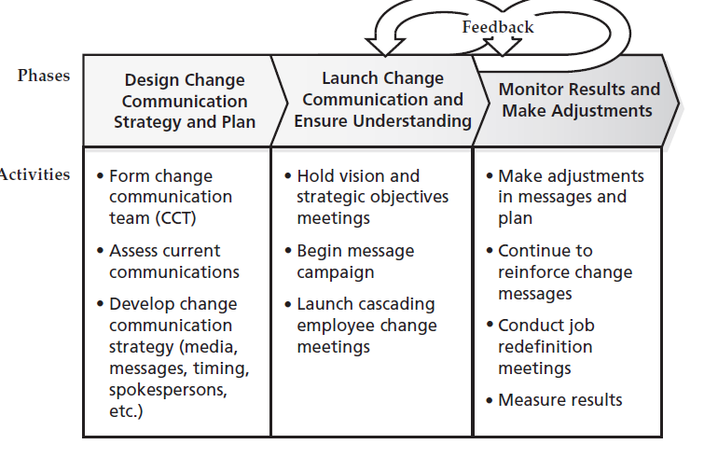
EXHIBIT 13.7 Three-Phased Change Communication Action Plan (page 363-371)
)

Slide 19
https://www.youtube.com/watch?v=QWORFliXxn0

Slide 20
Levels of Change Communication Effort
Level 3: Major
All of strategic program plus employee work- shops to redefine work habits and change employee behavior at all levels with frequent
program and performance feedback and assessment
Level 2: Strategic
Strategic messages, using all vehicles but relying primarily on interactive meetings with periodic program and performance assessment
Level 1: Basic
Targeted, strategic messages, mostly one-directional, with periodic assessment
13-20
Notes:
Is employee communications not hurting business or day-to-day operations enough to justify a strategic improvement program or a major change program? Then, a basic improvement program may suffice. That would involve improving messages, media, and assessment.
If much more is needed, such as strategic redirection to answer competitive threats or the need for major operational improvements to streamline operations or cut costs, then a major change program may be needed.
However, if the company’s needs are somewhere in the middle, then a strategic improvement program is the appropriate level to select for the employee communication improvement program. In fact, level 2 works for most companies because it will bring about significant improvement without a major disruption to the organization and sets the stage for major change if a full-blown change program is needed.

Slide 21
Essential Change Communication Steps
Form a cross-functional, multi-level communication team
Assess current employee communication practices against best practices
Target gaps in communication for immediate improvement
13-21

Slide 22
Essential Change Communication Steps (continued)
Develop a vision and strategic objectives if needed
Conduct cascading vision, strategy, job redefinition workshops
Monitor the results and make adjustments if find communication breakdowns
13-22

